Slide 1
Understanding and Supporting Gender Diverse Students
Todd A. Savage, Ph.D., NCSP
Professor, University of Wisconsin-River Falls
Pronouns: He/Him/His
Virtual Professional Development Series
New Jersey Association of School Psychologists
December 15, 2023

Slide 2
Session Objectives
To enhance participants’ awareness of gender identity and gender diversity matters in schools;
To augment participants’ knowledge base related to gender diversity as well as the impact of trauma and other factors on gender diverse students;
To highlight strategies participants can employ to support gender diverse
students and to improve school climate as it pertains to gender diversity.

Slide 3
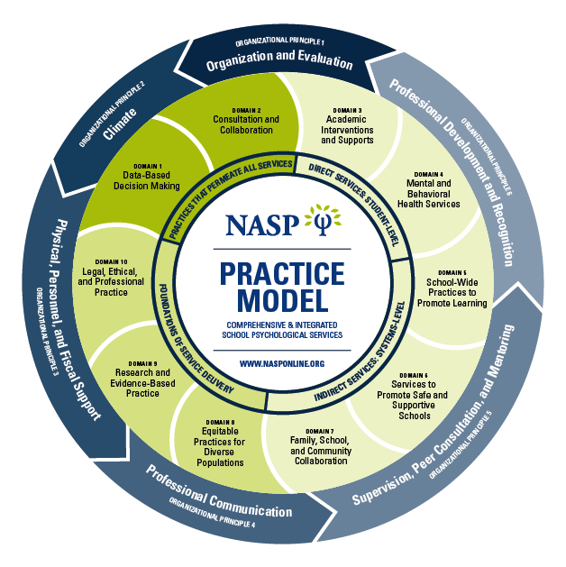
NASP Practice Model (2020)

Slide 4
NEA’s Position
Teaching Strategies (http://www.nea.org/tools/30420.htm)
“NEA believes that a great public school is a fundamental right of every child - free from intimidation and harassment, and safe for all students, including those who identify as gay, lesbian, bisexual, and transgendered.”
“There is only one real issue for educators: We are responsible for our students' safety and education. We must ensure that everyone is given the opportunity to achieve and thrive.”

Slide 5
Principal Professional Associations
National Association of Elementary School Principals
https://www.naesp.org/communicator-may-2016/new-resource-supporting-transgender-students
National Association of Secondary School Principals
https://www.nassp.org/who-we-are/board-of-directors/position-statements/transgender-students?SSO=true

Slide 6
NASP’s Position
Position statement (2022):
Safe Schools for Transgender and Gender Diverse Students
“The National Association of School Psychologists (NASP) supports the civil, human, and educational rights of transgender and gender diverse (TGD) students. NASP further asserts that to optimize TGD students’ academic, social, emotional, behavioral, and development potential, schools must be safe, secure, equitable, and inclusive environments for all students. NASP’s longstanding commitment to policy that calls for nondiscrimination and the promotion of equal opportunity, fairness, justice, and respect for all persons is reflected not only in NASP’s Professional Standards (NASP 2020b) but is reflected in its collection of position statements focused on lesbian, gay, bisexual, transgender/gender diverse, queer (LGBTQ+), and other minoritized youth throughout the past 30 years (NASP, 1999).”

Slide 7
Additional Statements
American School Counselor Association
ASCA: The School Counselor and Transgender/Gender-nonconforming Youth
American School Nurses Association
NASN: LGBTQ Students
School Social Work Association of America
SSWAA Resolution Statement: School Social Work Supports the Educational and Civil Rights of Transgender Students

Slide 8
Think/Pair/Share
What is your understanding of what it means to identify as ‘transgender’ or ‘gender diverse’?
How is ‘gender identity’ distinct from ‘sexual orientation?’
When do individuals become aware of their gender identity?

Slide 9
Definitions
Sex
Think biology – Female/Male
Gender
Social construction that is culturally-mediated – Girl/Woman, Boy/Man
Gender Identity
Lived/defined by the individual
Gender Expression
How people communicate their gender identity to others
Gender Role
Culturally-mediated ways people live out gender – Feminine/Masculine
Sexual Orientation
One’s primary psychological, social, emotional, and erotic attractions to other people

Slide 10
Definitions (continued)
Cisgender
Gender identity matches the sex and gender one was assigned at birth
Transgender
Gender identity does not match the sex and gender one was assigned at birth
Consistent, persistent, insistent
Gender Diverse
Broader category that captures the range of gender identities

Slide 11
Transgender Youth
• 80% of TG-identified adults knew they were ‘different’ before
leaving elementary school
• Less than 4% of TG-identified persons realized they were TG
after the age of 18
• Average age of trans-spectrum self-realization: 7.9
• Average age of learning the ‘words’ to communicate feelings: 15.5
Consistent, Persistent, Insistent
• Transitions pre-puberty are social in-nature; some persons make seek
medical transitions around puberty or later
Hyun, Raff, & Trier (2012)

Slide 12
Gender Diversity and ASD
Numerous anecdotal observations and emerging research are demonstrating an association between gender diversity and autism spectrum disorder (ASD)
Children and adolescents on the autism spectrum are seven (7) times more likely to be gender diverse
Children and adolescents at appearing at gender clinics are 6-15 times more likely than their same-aged peers to have ASD
Strang et al. (2017)

Slide 13
Mental Health Issues
Diagnostic & Statistical Manual of Mental Disorders (5 TR)
Gender dysphoria
Higher rates of depression and anxiety; lower levels of self-esteem; high rates of substance use/abuse and risk-taking behaviors
Suicide attempt rate
82% of TG/GD youth report having considered suicide
40% of TG/GD youth report having attempted suicide
10-20% of LGB-identified persons
3-5% of the general population
Austin et al. (2022)

Slide 14
School Issues School Climate: Transphobia, Bullying, Biased Remarks, Harassment
43% (GE) and 40% (GI) reported feeling unsafe at school because of the climate; online learners least likely to feel safe
43% (GE) and 39% (GI) reported avoiding gender-specific spaces or classes because of the climate
79% of LGBTQ+ students reported avoiding extra-curricular activities and/or school functions
16% of LGBTQ+ students changed schools because they felt unsafe or uncomfortable at school
GLSEN 2021 National School Climate Survey

Slide 15
School Issues School Climate: Transphobia, Bullying, Biased Remarks, Harassment
32% of LGBTQ+ students missed at least one entire day of school in the past month because of negative school climates and 11% missed four or more days in the past month
92% of LGBTQ+ student heard negative gender expression remarks
56% heard these remarks frequently
83% of LGBTQ+ students heard negative trans-specific remarks
40% heard these remarks frequently
GLSEN 2021 National School Climate Survey

Slide 16
School Issues School Climate: Transphobia, Bullying, Biased Remarks, Harassment
72% of LGBTQ + students heard negative gender expression remarks from adults
57% (GE) and 51% (GI) verbally harassed at school
20% (GE) and 25% (GI) physically harassed at school
54% LGBTQ+ students reported being sexually harassed at school
GLSEN 2021 National School Climate Survey

Slide 17
School Issues School Climate: Transphobia, Bullying, Biased Remarks, Harassment
32% (GE) and 30% (GI) reported being cyber-bullied based on their identities
62% LGBTQ+ did not report such incidents
60% of LGBTQ+ students reported school staff did not respond when negative gender identity/expression remarks were made by other students. Students learning via online means reported the lowest level of intervention by teachers.
GLSEN 2021 National School Climate Survey

Slide 18
School Issues Discriminatory School Policies and Practices
59% experience anti-LGBTQ+ polices and practices
16% of LGBTQ+ students were prohibited from discussing or writing about LGBTQ+ topics in school assignments, and 17% were prohibited from doing so in extracurricular activities
25% of LGBTQ+ students reported being disciplined for PDA
GLSEN 2021 National School Climate Survey

Slide 19
School Issues Discriminatory School Policies and Practices
12% restricted from forming or promoting GSA’s
29% prevented from using declared name and/or pronouns
27% prevented from using restrooms and 24% prevented from using locker rooms that aligned with their gender identities
GLSEN 2021 National School Climate Survey

Slide 20
School Issues Discriminatory School Policies and Practices
20% prevented from wearing clothes considered “inappropriate” based on gender
12% of LGBTQ+ students were prevented from wearing clothing or items supporting LGBTQ+ issues
16% were prevented or discouraged from participating in school sports because of their LGBTQ+ identity
GLSEN 2021 National School Climate Survey

Slide 21
Effects of a Hostile Climate
Three times more likely to have missed school in the past month
Reported lower sense of belonging at school
Had lower GPAs than non-harassed peers
Twice as likely to report not looking to pursue PSE
Twice as likely to have been disciplined at school
Were consider leaving school (31% to 51%)
GLSEN 2021 National School Climate Survey

Slide 22
Legal & Policy Matters
Title IX (Patsy Mink Equal Opportunity in Education Act, 2002)
U.S. Department of Education Office of Civil Rights considers gender identity and gender expression as protected classes under Title IX
The DOE-OCR and the U.S. DOJ have filed and won lawsuits in this regard
FERPA
According to Lambda Legal, students (ages 18+) and/or parents or legal guardians have the right to request a school change the name and gender marker on a student’s records if they are incorrect, misleading, or violate one’s privacy [34 C.F.R. section 99.7(a)(2)(ii)]
Section 504 of the Rehabilitation Act of 1973
- Gender identity is not a disability in-and-of itself
- Focus on disability in the 504 plan, not on gender identity
If the disability for which one is seeking accommodations centers on mental health sequelae associated with one’s gender identity and that impacts one’s education, it would be appropriate to develop a 504 plan in this situation

Slide 23
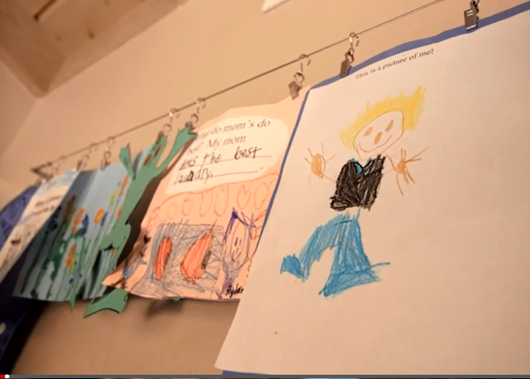
Raising Ryland
http://www.cnn.com/videos/us/2015/03/17/digital-shorts-parenting-transgender-child-orig.cnn?sr=fbdwtransp

Slide 24
Schulyer Bailar
https://www.youtube.com/watch?v=niBM3Ii662U

Slide 25
Strategies

Slide 26
Tier 3:
Child Protective Services
Mandated reporting
Coordination of services
Releases of information in both directions
Referral to community-based medical services
Referral to community-based mental health services
Tier 2:
Individual counseling
Group counseling
'Deeper dives' with those who pop up on screenings
Family support initiatives
Gender Transition Plan Development
Gender Support Plan development
School climate 'booster shots'
Tier 1
Access to mental health professionals and services
Universal mental health education, depression and suicide awareness education, and screening
Anti-bullying prevention and bystander education
Access to curricular and instructional materials
Access to gender-safe spaces
Inclusive language
Trauma-informed/trauma-sensitive schools
Gatekeeper training
Confidentiality and respect
Policy development, revision, updates
Establishment and maintenance of an overall positive school Climate

Slide 27
Resources
National Association of School Psychologists (NASP)
Gay, Lesbian and Straight Education Network (GLSEN)
Transparenthood (Blog)
TransActive Gender Center
Welcoming Schools
Gay, Lesbian, Bisexual, and Transgender Community Center
TransYouth Family Allies
Philadelphia Trans-Health Conference
TNET – PFLAG’s Transgender Network

Slide 28
References
Austin, A., Craig, S. L., DeSousa, S., McInroy, L. B. (2022). Suicidality amongst transgender
youth: Elucidating the role of interpersonal risk factors. Journal of Interpersonal
Violence, 37, 5-6.
Gay, Lesbian and Straight Education Network. (2022). The 2021 National Climate Survey.
New York: Author.
Gender Spectrum. (2015). Schools in transition: A guide for supporting transgender students
in k-12 schools. Oakland, CA: Author.
Hyun, J. H., Raff, R., & Trier, B. (2012). Helping transgender youth. Presentation made at
the annual meeting of the Washington School Counselors Association Meeting.
Reeves, M. A., & Brock, S. E. (2011). PREPaRE workshop 1: Crisis prevention &
preparedness: Comprehensive school safety planning (2nd ed.). Bethesda, MD: National
Association of School Psychologists.
Savage, T. A., Springborg, H. L., & Lagerstrom, L. (2017). District and school transgender
and gender diverse readiness assessment form. Minneapolis, MN: Authors.
Strang, J., Kenworthy, L., Dominska, A., Sokoloff, J., Kenealy, L. E., et al. (2014). Increased
gender variance in autism spectrum disorders and attention deficit hyperactivity
disorder. Archives of Sexual Behavior, 43, 1525-1533.
Will, M. (2019, September 18). Teachers on front lines of making schools safe for
transgender kids. Education Week, 39(5), 1 & 14.

Slide 29
Questions?
Todd A. Savage, Ph.D., NCSP
Professor, University of Wisconsin-River Falls
todd.savage@uwrf.edu
Leslie Lagerstrom
Mom, Author, Advocate
transparenthood.net
leslie@transparenthood.net

