Slide 1
Solution-Focused Counseling (SFC) in Schools
John J. Murphy, Ph.D.
Belleville-Kean-NJASP Webinar
January 12, 2024

Slide 2
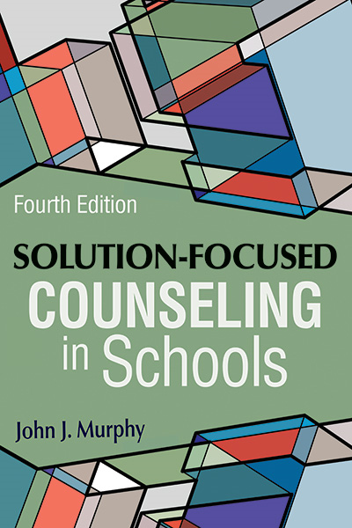
SFC Principles & Assumptions
Students are resilient, resourceful, and capable.
Cooperation enhances solutions.
Nothing happens constantly.
Small changes lead to bigger changes. (pp. 34-37)
The solution is not necessarily related to the problem.
The language of solutions is different than the language of problems.
If it’s not broken, don’t fix it; If it works, do more of it. If it doesn’t work, do something different.

Slide 3
Definition
Solution-focused counseling (SFC) invites people to describe what they want from counseling and use what they have to achieve it in the shortest time possible. (p. 3)

Slide 4
Demonstration
*As you watch the demonstration, notice similarities and differences between the practitioner’s approach and your approach to working with students and others (teachers, parents, . . .).

Slide 5
3 Main Tasks
Setting a Direction
Set a direction (goal/desired outcome) based on what student/client wants from counseling
Building on Exceptions & Resources
Build on exceptions and other student resources
Exploring Progress
Explore progress toward desired outcome

Slide 6
3 Main Techniques (Ask, Listen Amplify)
Ask questions rather than trying to persuade, convince, or tell the student what to do
Listen closely to the student’s answers (the most important SFC technique; foundation of asking and amplifying)
Amplify aspects of students, their lives, and their comments that support desired outcomes
*When being purely solution-focused, practitioners rarely do anything outside of these techniques.

Slide 7
Task 1: Setting a Direction
What does client want from services?
“What are your best hopes from coming here? How would you know this was useful?” (desired outcome)
“If a miracle happened tonight while you were asleep and …this problem vanished OR… you (insert student’s desired outcome), what would you notice first when you woke up? What else? …”
Elicit detailed description of desired outcome (referred to as client’s “preferred future” or “solution description”)
Miracle (or Tomorrow) Scale” “On a scale of 0 to 10, where 10 means you’re just where you want to be on (desired outcome, such as “being more chill/relaxed”) and 0 is the exact opposite, where would you put yourself now?”; “What would be a ‘good enough’ number?” (Additional Workshop Materials, p. 4)

Slide 8
Task 2: Building on Exceptions & Other Resources
What does client have toward achieving desired outcome?
(see Additional Workshop Materials, p. 4, for more questions)
Eliciting/Exploring/Expanding Exceptions*
[If client’s 0-10 rating on miracle scale has ever been lower]: What’s different now
compared to then? When is the problem less noticeable? What pieces of the
miracle are happening, even a little? What’s different about those times? How
did you make it happen? What would help to make it happen even more?
Eliciting/Exploring/Expanding Other Resources
What (or who) else might help? How have you handled other struggles? How
have you managed to get all the way to 3rd grade? What do you think might help
Turn things around? How can your skateboarding skills help you with this?
*Discussing exceptions often reveals traits, actions, social supports, resilience, &
other useful resources that can help students move forward.

Slide 9
Task 3: Exploring Progress
What progress has client/student made & what are possible next signs/steps toward more progress?
“What’s better since the last time we met?”
“How did you move up a whole point (on 0–10 scale)? What helped
you do that?”
“How do you keep going? How have you kept things from getting
worse?”
“What might be the next small sign (or step) to move you a little
closer to [insert client’s desired outcome])?”
*See Additional Workshop Materials, p. 4, for more questions to
consider when people report progress or no change/declines from
one session to the next.

Slide 10
Format of First & Later Sessions in SFC (See Additional Materials, pages 2 & 3)
First Sessions
1. Opening interactions
2. Setting a direction
3. Building on exceptions (& other resources)
4. Exploring progress (pp. 17-21; 382-383)
5. Closing
Later Sessions
Explore between-session progress (0-10 scale; “What’s better?”)
Barring a change in the student’s desired outcome, proceed
through Steps 3, 4, and 5 above

Slide 11
Why Does Solution-Focused Counseling Fit with Schools & School Practitioners?
Practical
Brief
Culturally responsive
Student centered
Strengths based
Evidence-based
Portable
Adaptable
Compatible with IEP goals/requirements
Aligned with values, ethics, & standards of the helping professions (NASP Practice Model, , ASCA, SSWAA, ...)

Slide 12
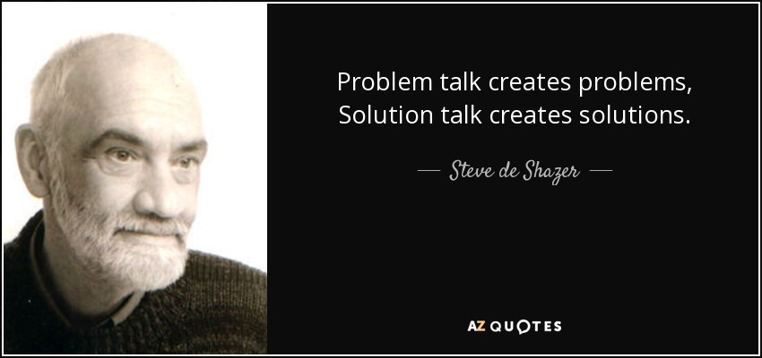
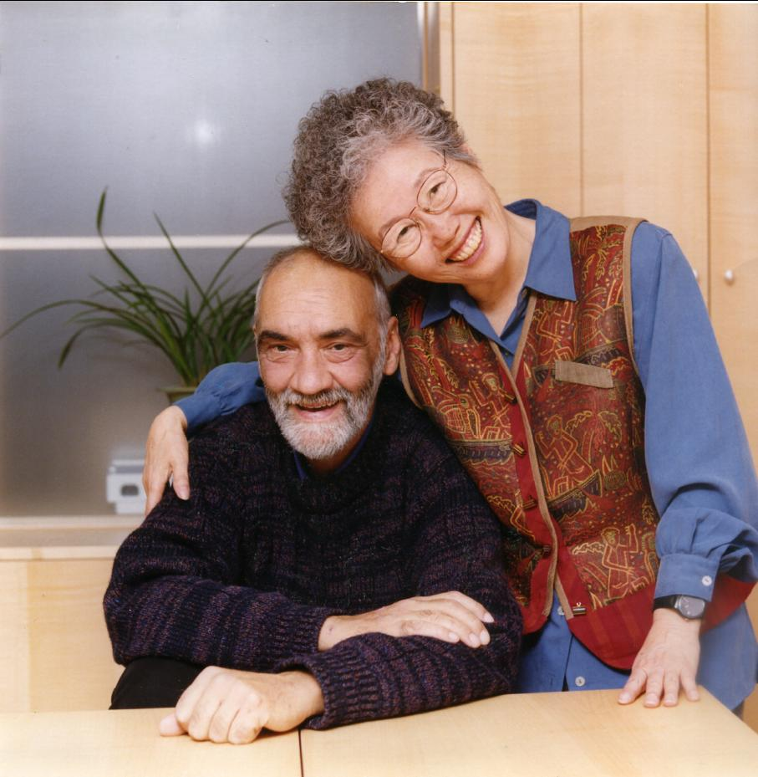
Co-Founders of Solution-Focused Brief Therapy Historically psychotherapy has concerned itself with problems (variously defined) and solutions (seldom defined), with problems receiving the major share of the effort. —Steve de Shazer
That’s a way to see it and there is also another way to see it. —Insoo Kim Berg
*Developed SF approach by watching actual therapy sessions with attention to question, “What do clients and therapists talk about when therapy is successful?”

Slide 13
2 Myths (& Facts) About SF Approach
Myth: SF approach ignores/minimizes client problems.
Fact: SF practitioners fully acknowledge clients’ pain and problems and provide space for clients to describe them…and then ask what they want instead.
Myth: SF approach works for mild but not serious problems.
Fact: SF approach is as effective as other established approaches in helping clients with a wide range of psychological, social, and behavioral difficulties—including trauma and other significant challenges.

Slide 14
Evidence Base of SF Therapy/Counseling
150+ randomized clinical trials (RCTs) in many countries and cultures
Multiple meta-analyses & research reviews
Microanalyses (process research) supporting impact of SF change mechanisms/processes (SF questions, co-construction, client-therapist dialogue)
Indirect support of client-directed/solution-focused approach: Research on common factors of therapeutic change (Additional Workshop Materials, Page 6)
CONCLUSION: SF therapy/counseling is a transcultural approach that yields similar overall client outcomes (effect sizes) as other evidence-based, established approaches. . . and does so in fewer sessions.

Slide 15
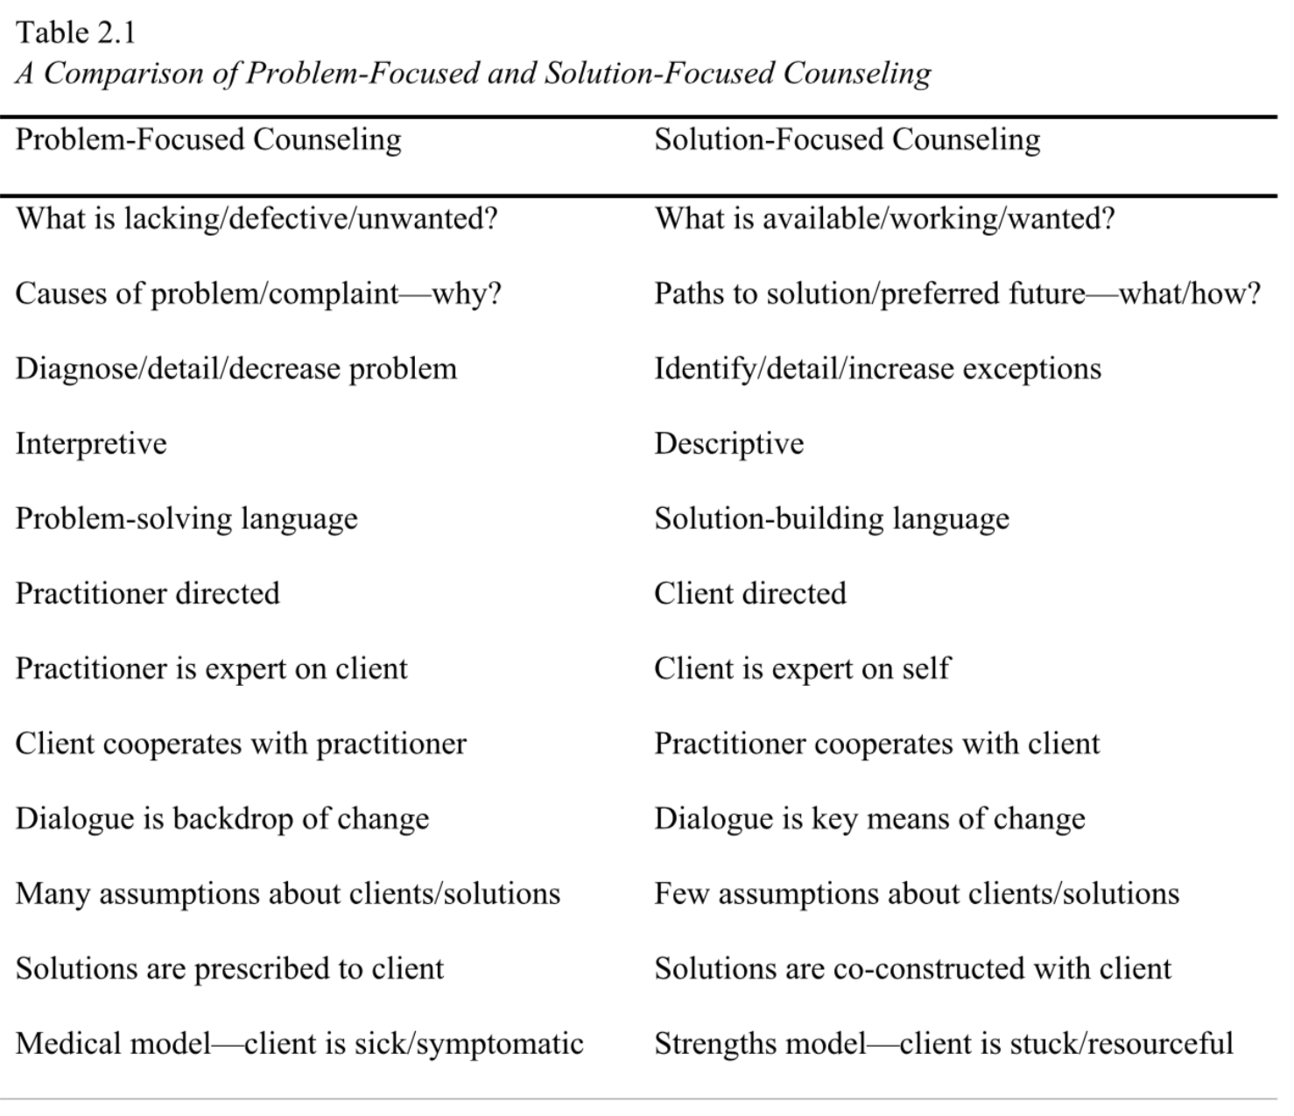
Differences Between Solution-Focused & Problem-Focused Counseling (Murphy, 2023; Table 2.1, p. 48)

Slide 16
Comments/Questions?

