Slide 1
BEYOND THE TEST: CULTURALLY COMPETENT REAL WORLD BEST PRACTICES IN SCHOOL PSYCHOLOGY
By Dr. Joel Bocanegra NCSP
Chair SPEL ISU
Training Coordinator: School Psychology program
Bocajoel@isu.edu

Slide 2
TODAY
Agenda:
A little about me… Some buy-in maybe?
What is diversity/multiculturalism?
Some best practices in MC assessment?
Common obstacles?
QA?

Slide 3
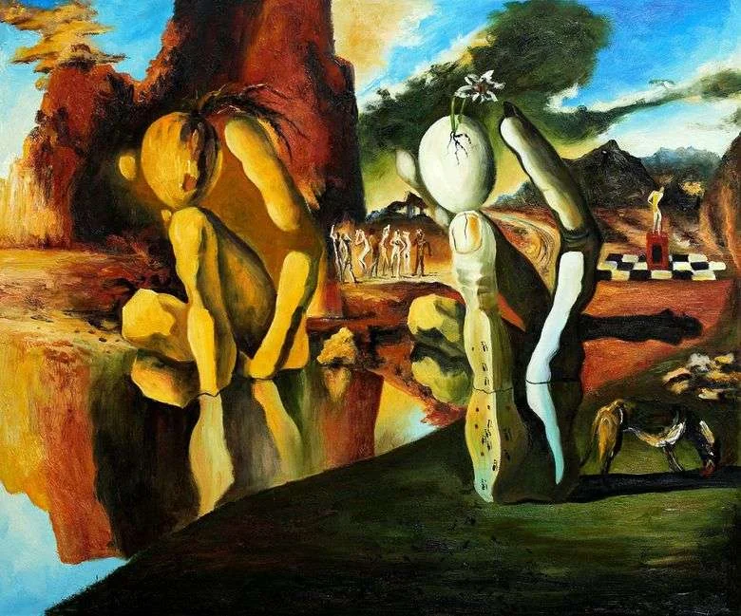
¿VANITY SECTION or buy-in?
Born in PR
Bilingual
Military Brat
Lived throughout the US
Graduated PHD from UWM
Research area is MC, Diversity, system change, etc.
Teach MC and clinical courses, among others
Professor at ISU
Licensed Psychologist
Certified school psychologist
Have consulted and worked internationally
Owner and director of:
small clinic (BPEAS PLLC)
consulting training organization (Training Performance Institute)
Experience working in:
urban, rural, reservation, immersion, bilingual, and international schools

Slide 4
CHALLENGE
But I challenge everyone in this room to truly reflect upon what is diversity and why does it matter to me.
And what am I willing to do to support and/or fight for it.

Slide 5
WHAT IS DIVERSITY?
The Power of US

Slide 6
DEFINITIONS
“the condition of having or being composed of differing elements : VARIETY. Especially : the inclusion of different types of people (such as people of different races or cultures) in a group or organization” (Merriam-Webster, 2020)
“Diversity refers to the mixture of differences and similarities that can exist among a combination of individuals (Thomas, 1999)” – APA, 2020- Diversity Handbook.

Slide 7
TO ME…. DIVERSITY AND MC IS ABOUT OUTCOMES
Its about allowing people to flourish… regardless of their differences
Its about providing fertile ground where roots can take hold and our seeds of knowledge and excellence can shoot for the sky in the hopes of a better tomorrow
Its about doing no Harm.

Slide 8
IN REAL WORLD PRACTICE … AND TRAINING.
There is often an intersection and/or conflict.
Between
Legal Practice
Best Practice
Ethical Practice
Common Practice

Slide 9
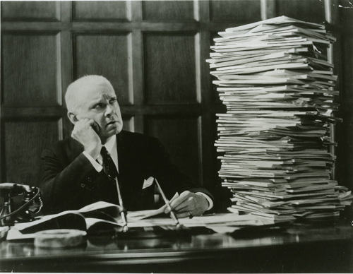
Common Components of MC
Not an exhaustive list

Slide 10
MC ASSESSMENT
Common best practices:
Good MC competent pre-referral process
With competent and MC knowledgeable people
Taking into account
Background
Language
Exposure
Classroom
Culture
Etc.
Notes:
There's a lack of good scientific research. Lots of it is driving by guiding principals by numerous organizations, ethical imperatives, case laws, screw-ups, mess-ups, oops, and related research.
Also, it is important to note: I tell the stories, they have the books.

Slide 11
MC ASSESSMENT
Common best practices:
Training in MC Assessment
Understanding of language acquisition process
Cultural differences
Political issues
Zeitgeist
Knowing how to rule-out
Know the instruments and communities
Good people skills and interviewing skills
Notes:
There's a lack of good scientific research. Lots of it is driving by guiding principals by numerous organizations, ethical imperatives, case laws, and related research.

Slide 12
MC ASSESSMENT
Common best practices for ELL:
Four things to consider:
1) Previous educational context
Quality of language program
CALP in L1
2) Comparing to other ELL students
Can be formal, informal, or both
3) Consistency across formal and informal data
4)ascertaining where the student is along ELL continuum
Side note: Accent≠ Fluency
Notes:
There's a lack of good scientific research. Lots of it is driving by guiding principals by numerous organizations, ethical imperatives, case laws, and related research.

Slide 13
MC ASSESSMENT
My best practices:
Have a thirst for knowledge
Appreciate seek to learn more about cultures
Have a backbone
But be crafty and know how to navigate environment in order to make long lasting change.
Go through the scientific process when conducting an evaluation, ruling out MC/diversity related causes
Create those hypothesis
Is this really a within person - disability or a external factor?
Use strength based perspective – leverage whenever possible.
In person interview and observation whenever possible
Notes:
There's a lack of good scientific research. Lots of it is driving by guiding principals by numerous organizations, ethical imperatives, case laws, and related research.

Slide 14
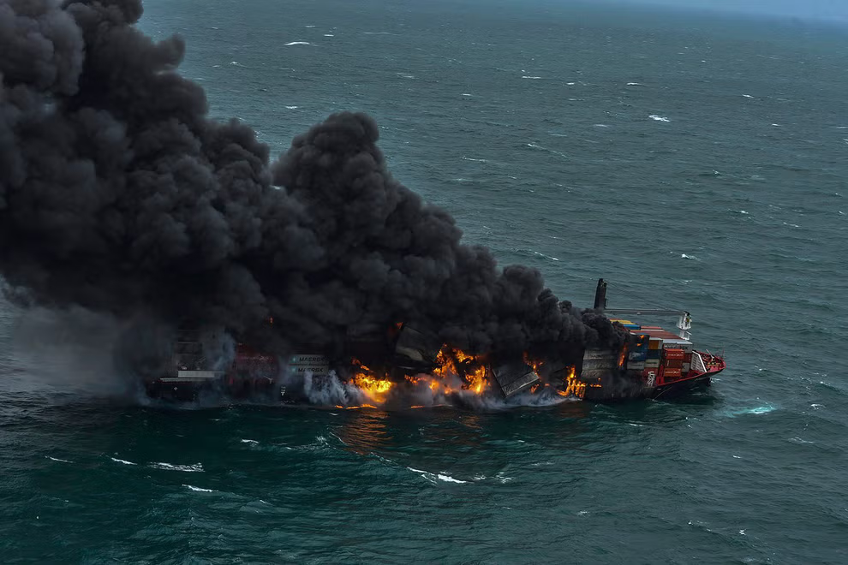
COMMON HURDLES
(Rigidness) Common/established practice
Resistance to change
Change can be slow –be patient
Get buy-in, build trust
Show success
Educate
(Zeitgeist) Laws, political movements
School being political entities and being impacted by them
Know the laws and zeitgeist.
Be crafty – in a good way
See above
(Stakeholders) Parents/teachers
Build rapport
See above
(Logistics) Time/resources
Show and document need
See above
(Chaos) Chaos
Try to establish routine and structure
See above
Identify whether its salvageable, worth going down with the ship, or its time to abandon ship

Slide 15
A SCHOOL IS A CRUISE SHIP… CHANGE TAKES TIME.

Slide 16
QA

Slide 17
Resources
Here are some of my resources but I can provide more specific resources in interested.
Current textbooks
Rhodes, R. L., Ochea, S. H., & Ortiz, S. O. (2005). Assessing culturally and linguistically diverse students: A practical guide. NY: The Guilford Press.
Balls, P., Marin, G., & Chun, K. M. (2018). Multicultural Psychology. 2nd. Rowan & Littlefield.
-------------------------------------------------------
Suzuki, L. A. & Ponterotto, J. G. (2008). Handbook of multicultural assessment: Clinical, psychological, and educational application. San Francisco, CA: Jossey-Bass.
Lopez, E. Nahari, S., & Proctor, S. (2017). Handbook of Multicultural School Psychology: An Interdisciplinary Perspective
Selected reading from Best Practice Books
http://www.pbs.org/race/000_General/000_00-Home.htm
https://understandingrace.org/
http://www.splcenter.org/index.jsp
https://implicit.harvard.edu/implicit/demo/selectatest.jsp

